Slide 1

Department of Information Technology
NBA Accredited A.P. Shah Institute of Technology G.B.Road,Kasarvadavli, Thane(W), Mumbai-400615 UNIVERSITY OF MUMBAI Academic Year 2021-2022

Slide 2
A Project Report on Automation of Supply Chain Management for Healthcare Submitted in partial fulfilment of the degree of Bachelor of Engineering(Sem-8)
in
INFORMATION TECHNOLOGY By Hitarth Saiya(19204007) Jash Seth(19204006) Samyak Doshi(19204001) Under the Guidance of Prof. Vishal Badgujar Prof. Geetanjali Kalme

Slide 3
1.Project Conception and Initiation

Slide 4
1.1 Abstract
Nowadays, the need for systematic deliverance of the healthcare sector is much sought-after. Such, that a simple delay in restocking of certain medicines or supplies could create unrest among the mass, and result in the loss of healthcare facilities for many. Robotic Process Automation (RPA) is a software technology that can create, deploy, and manage bots that emulate certain human actions interacting with digital systems and software. Robotic Process Automation is one of the technologies that can be used to carry out the smooth sailing of the supply chain process. This paper will describe how RPA technology can be used to emulate the various processes in the supply chain management for a healthcare entity, such as checking inventory, reading and comparing vendor quotations, and finalizing a supply vendor.

Slide 5
1.2 Objectives
To automate inventory management System.
To maintain the adequate stocks of medications.
To minimize the occurrence of unexpected out-of-stock scenarios resulting from depletion or expiration of inventory.
To automate vendor selection Process.
To automate vendor On Boarding Process.

Slide 6
1.3. Literature Review
Sr.No. | Authors | Title | Methodologies | Findings
1 | Allam Maalla | Development Prospect and Application Feasibility Analysis of Robotic Process Automation | Study the enterprise problems that RPA can solve, Feasibility analysis of RPA application. | With the development of artificial intelligence, the combination of artificial intelligence technology with automation technology will make RPA more competitive.
2 | Yatskiv, S., Voytyuk, I., Yatskiv, N., Kushnir, O., Trufanova, Y., & Panasyuk, V. | Improved Method of Software Automation Testing Based on the Robotic Process Automation Technology | Compared two main approaches i.e. Selenium Web Driver & WorkFusion, to the test automation. | The most effective RPA automation is when user interacts with different applications and needs to have specific actions done before test execution.

Slide 7
1.4 Problem Definition
Pharmaceutical Company's Inventory is controlled and managed using a warehousemanagement system. However, the activities performed on the system are mostly repetitive , rule-based, mundane, time and labor intensive. At times due to lack of management, products of pharmaceutical inventories are not ordered on time, which causes delay and it may also lead to a panicking situation amongst the citizens during hard times. Thus, there is need of Inventory management using RPA. So if the stock of product is reduced then it can be re-ordered automatically. To be precise, in this pandemic situation the need of medicines has increased. So, if the stock of it reduces and reaches to the threshold value then it can be re-ordered immediately and no delay will occur.

Slide 8
1.5 Scope
Using autonomous bots we can finalize the vendor selection and vendor onboarding in accordance with predefined criteria.
We can automate the order processing task to reduce the workload of manual process.
We can automate the inventory management so that bot can notify when stock level are low, also reorder the products that go below a threshold level, etc.

Slide 9
1.6 Technology stack
Back End:-
RPA Tool (Blue Prism)
SQL Express
C#
Front End:-
HTML
CSS
Java Script

Slide 10
1.7 Benefits for environment & Society

Slide 11
2. Project Design

Slide 12
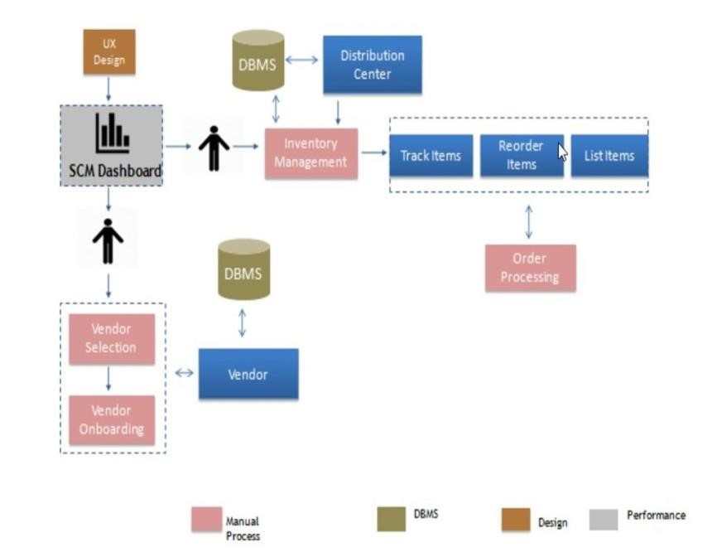
2.1 Existing System

Slide 13
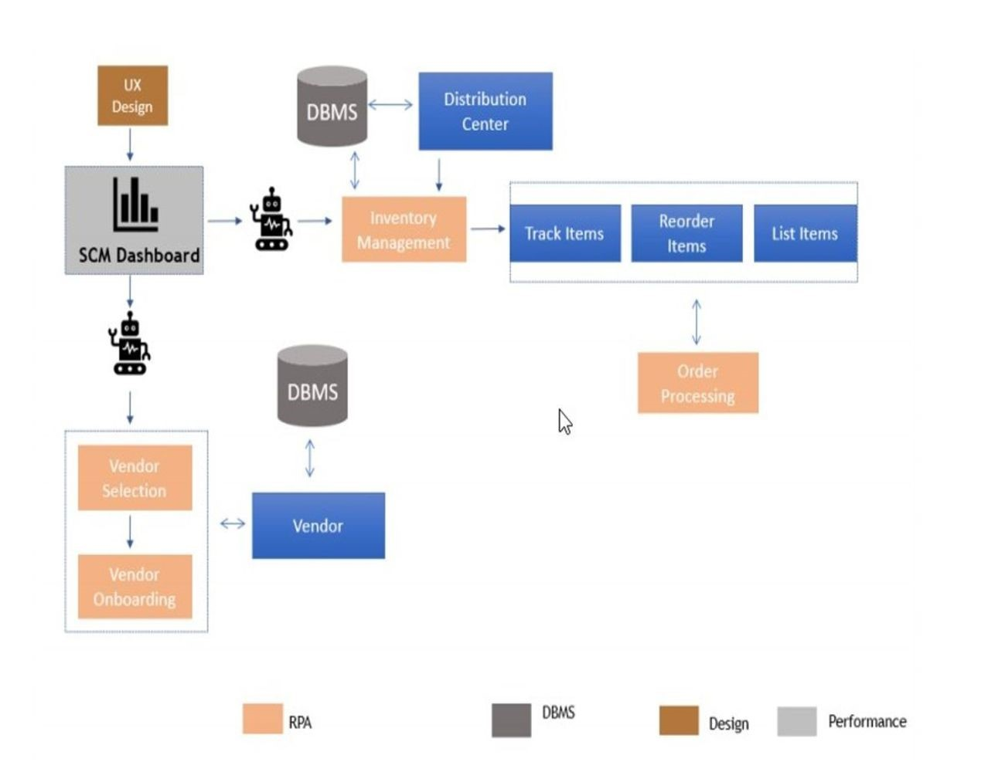
2.2 Proposed System

Slide 14
2.3 Design(Flow Of Modules)
https://lucid.app/lucidchart/invitations/accept/inv_7d8e1ff2-74bd-4f0b-a543-a59a81842f9f?viewport_loc=-1341%2C79%2C4377%2C1696%2C0_0

Slide 15
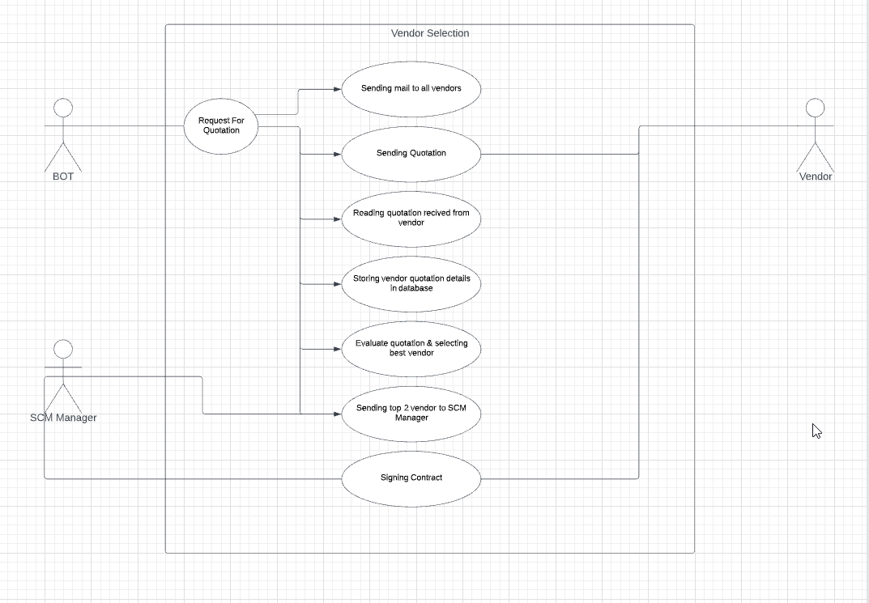
2.4 Description Of Use Case

Slide 16
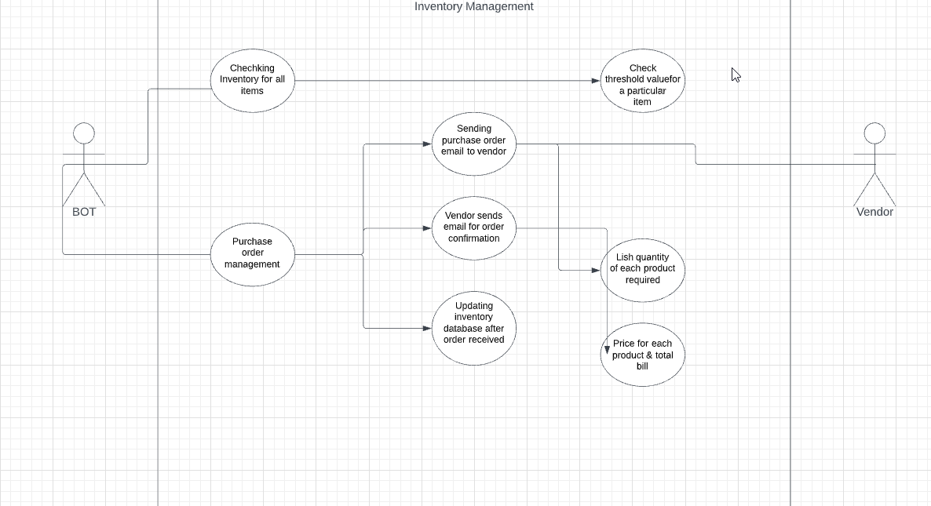
2.4 Description Of Use Case

Slide 17
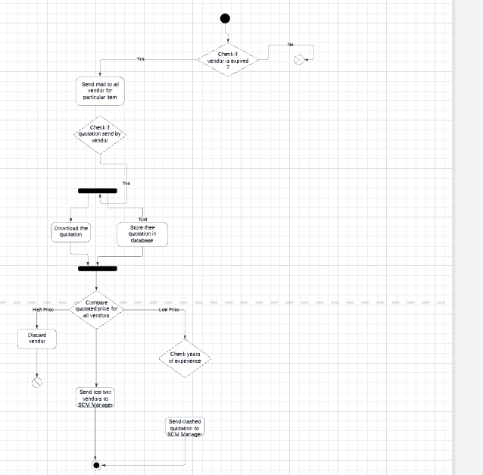
2.5 Activity diagram

Slide 18
3. Implementation

Slide 19
6. Conclusion and Future Scope

Slide 20
6.1Conclusion
The existing supply chain framework has a lot of shortcomings and we believe these are mainly because of the human management of processes. So, we have proposed a novel supply chain management framework in the healthcare sector, using Robotic Process Automation. By programming BOTs to automate certain processes in a system which were previously handled manually, we can overcome the several shortcomings in the supply chain management system, such as frequent human errors, excess delay, inaccuracies, etc. Automating the key processes, such as Vendor Selection, Vendor on boarding, Inventory Management and Order Processing with the help of RPA Tool, can help us make the system more reliable and easier to implement.

Slide 21
References
A. Maalla, "Development Prospect and Application Feasibility Analysis of Robotic Process Automation," 2019 IEEE 4th Advanced Information Technology, Electronic and Automation Control Conference (IAEAC), 2019.
S. Yatskiv, I. Voytyuk, N. Yatskiv, O. Kushnir, Y. Trufanova and V. Panasyuk, "Improved Method of Software Automation Testing Based on the Robotic Process Automation Technology," 2019 9th International Conference on Advanced Computer Information Technologies (ACIT), 2019.
S. Voeng and D. Kritchanchai, "Factors Influencing Supplier Selection for Vendor Managed Inventory Adoption in Hospitals," 2019 4th Technology Innovation Management and Engineering Science International Conference (TIMES-iCON), 2019.

Slide 22
Paper Publication
Paper entitled “Automation of Supply Chain Management for Healthcare” is presented at “3RD International Conference on Deep Learning, Artificial Intelligence and Robotics, (ICDLAIR) 2021”

Slide 23
Thank You

Slide 24
Blank diagram: Lucidchart

